Slide 1
UW-Madison
Central Audit Onboarding
Expenses
Allie Watters & Meghann Grove
Division of Business Services

Slide 2
Summary
With Workday, UW-Madison is moving from a decentralized model of expense report approval to a centralized model of approval. In preparation for Workday, the Division of Business Services has created a team of centralized expense auditors and has invited select Divisions to join central audit prior to Workday Go-Live.
All remaining divisions will be incorporated into central audit with the launch of Workday on July 7, 2025.
To share information and help prepare Divisions for change impacts, the Travel and Card team is hosting 1:1 meetings with higher-volume units.

Slide 3
Benefits of Centralized Audit Model for Expenses
Greater Consistency in Audit Reviews: A dedicated team of auditors will ensure that expense reports are reviewed uniformly, providing fair and consistent application of university policies.
Increased Efficiency in Time to Approval: By centralizing the audit function, we anticipate faster turnaround times for expense report approvals, reducing delays and time to payment.
Enhanced Standardization: A centralized approach will ensure university-wide standards and compliance requirements are adhered to more rigorously across all divisions.

Slide 4
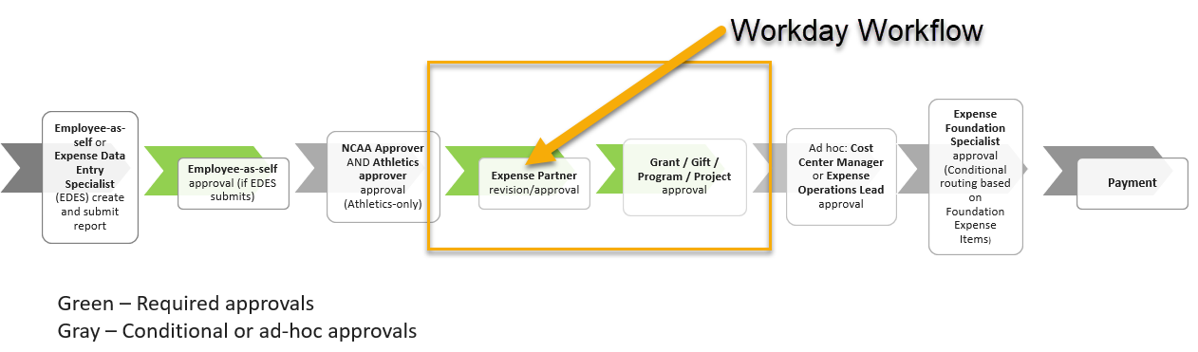
Workday Expense Workflow
In Workday, expense reports will route for approval first to Division of Business Services Expense Partners for policy compliance review. Following approval by Expense Partners, reports will route to Grant/Gift/Program/Project driver worktag manager approvers for budget and funding review.

Slide 5
Expense Parter Review – What to expect
Business purpose review
  Be sure to include a benefit to UW (research, teaching, outreach, or other mission-driven activity)
Data entry validation – auditors will confirm that expenses entered match receipts, supporting documentation (e.g., dates, dollar amounts, expense types)
Policy compliance review – auditors will ensure each expense meets the criteria for reimbursement as set forth in the relevant UW-Madison policy
  Example: If mileage is claimed, ensuring driver is authorized.
If there are questions on an expense report, the campus auditor will reach out to the Expense Data Entry Specialist or claimant directly via email.

Slide 6
Expense Partner Review – Sendback reasons
Central campus auditors will make every effort to keep workflow moving forward to ensure prompt payment/reconciliation. Having said that, there are certain situations where expense report sendbacks may occur.
An expense report will be sent back to the claimant/alternate if:
  There are three or more errors on the expense report (for example, a report has an insufficient business purpose, missing receipt, and missing agenda)
  There are expenses claimed that do not comply with policy that require an exception from the Divisional Business Office to pay/reimburse
    Report will be sent back with instructions to remove expenses or obtain a Divisional exception, attach the approval to the report and resubmit
  10 or more days have elapsed without a response from the claimant/alternate regarding outstanding questions on the expense report.
  Expenses are claimed that require an updated remote work agreement to validate the headquarters location and an updated remote work agreement is not on file.

Slide 7
Expense Foundation Specialist Review
  Expense reports are routed to Expense Foundation Specialists (DoBS Central Audit team) if an expense report contains Foundation Expense items
  DOBS staff have access to Foundation data and will be checking for the following:
    Appropriate billing to Foundation (vs. allowable on UW-Madison funding)
    Accurate split between UW-Madison and UW-Foundation
    Verifying Foundation account name and number entered are accurate
    Verifying Foundation account Department/Division matches the Cost Center on the expense report
    Staff will verify Foundation use code and Foundation MOU for allowability/donor intent for each fund billed
    Staff will check for sufficient available balance in each Foundation account, either in the spendable balance or if an account is quasi-endowment or temporarily restricted and able to spend from endowment.

Slide 8
What We’ve Learned During the Pilot Phase
Nonstandard policy application across campus
  Per diem allowances
  Student payments
  Sabbatical/Research Leave
  Licenses/Certifications
Units welcoming additional information/support for difficult policy areas, standardization of report requirements
Staff turnover not an issue; team is stabilized and building
Send-backs tend to increase during initial phase of implementation; decrease over time
Send-backs overall lower when an alternate creates the report
Data on Expenses and the central audit model has been crucial to our success and stakeholder understanding (Tableau dashboard)
Some areas requiring unnecessary detail, information or supporting documentation; realigned understanding of requirements has reduced administrative burden on report initiators

Slide 9
What We’ve Been Working On
Staffing model
Audit manual
Workload distribution and monitoring in Workday
Isolating key performance indicators to track and report on progress of central audit model across campus (time to approval by approval role, sendbacks)
Post-pay audit of central audit team’s work
Central Audit website
Workday resources, e.g., procedures, how-tos, help pages
Outreach efforts

Slide 10
Workday Expense Data & Divisional Check-ins
Data and Reporting: Will work with AIP in summer/fall to build new Workday Expense Tableau Dashboard
Divisional Check-ins: Developing schedule to meet with Divisional leadership semi-regularly to discuss metrics, progress of central audit model, any issues or questions that arise

Slide 11
Discussion
What are you looking forward to with Workday Expense central audit?
What are the main concerns with Workday Expense central audit?
What topics, policies, or requirements have proved most difficult in Expenses/P-card for your Division?
What unique aspects of your School/College/Division should we consider or be aware of as we onboard your unit to our team for Workday Expense?
What services or support can the central audit team or our office provide to improve this business process area for your School/College/Division?

Slide 12
Next Steps
Review the slide deck and let us know if you have any questions about the coming changes. Reach out to Allie Watters, Expense Reimbursement Program Manager, at allie.watters@wisc.edu.
With the launch of Workday, claimants, alternates, and departments may send questions on expense reports in process to the central auditor inbox expensepartnerpool@bussvc.wisc.edu or directly to the central auditor assigned on a report.

Slide 13
Resources
Central Audit webpage: https://businessservices.wisc.edu/about/accounting-services/centralized-audit/
Central Audit staff directory: https://businessservices.wisc.edu/about/accounting-services/
Expense Partner inbox: expensepartnerpool@bussvc.wisc.edu

Slide 14
Questions?
We’re here to support you!
Email Allie Watters allie.watters@wisc.edu

